Slide 1


Website Data Collection,
Browser Fingerprinting & API
Protection
Understanding how websites collect data, identify users, and protect their APIs

Slide 2

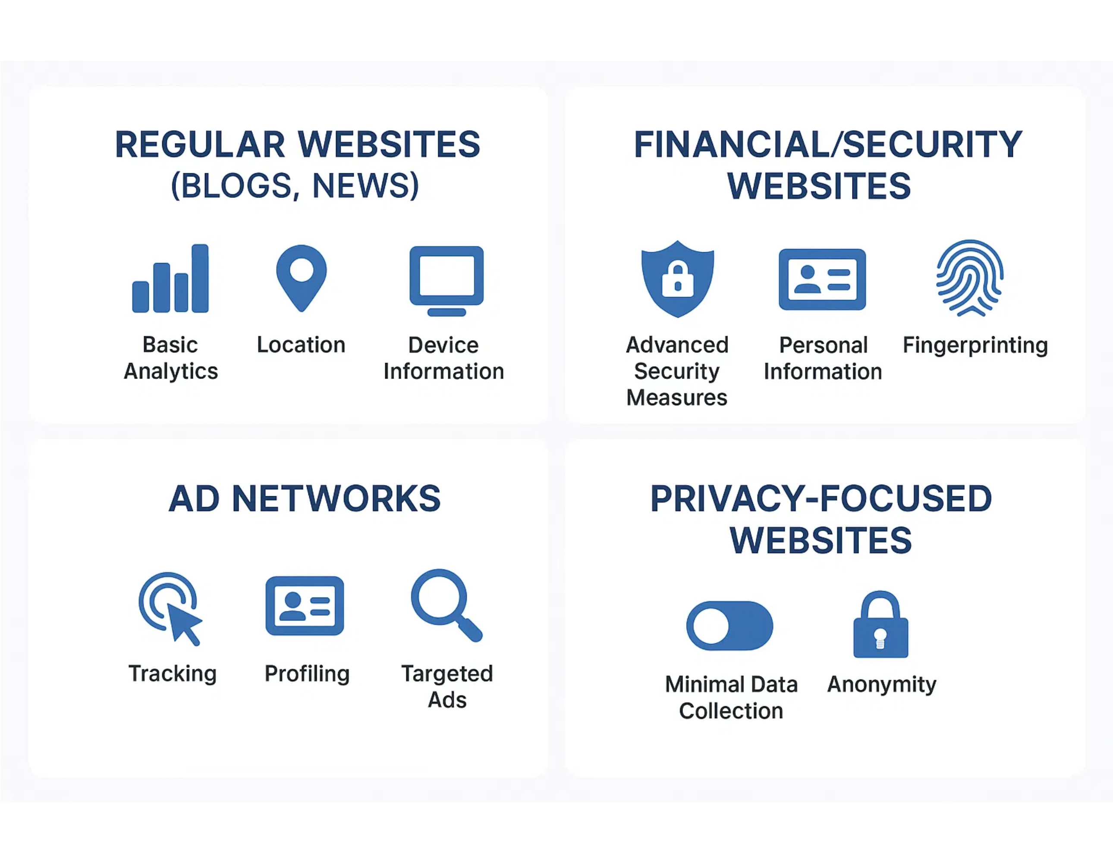
Types of Websites & Data Collection
Different types of websites collect varying amounts of data based on their purpose and business model:
Regular Websites (Blogs, News, E-commerce):
• Basic analytics, IP address, browser info
• General location and screen resolution
•
Don't typically collect
detailed hardware fingerprinting
Financial/Security Websites (Banks, NSE):
• Comprehensive fingerprinting for fraud prevention
• Advanced behavioral tracking and risk scoring
• Device registration and security monitoring
Ad Networks & Social Media:
• Cross-site tracking and behavioral profiles
• Purchase history correlation
• Extensive fingerprinting for user identification
Privacy-Focused Websites:
• Minimal server logs only
• No tracking scripts or fingerprinting
• Often use anonymization techniques

Slide 3
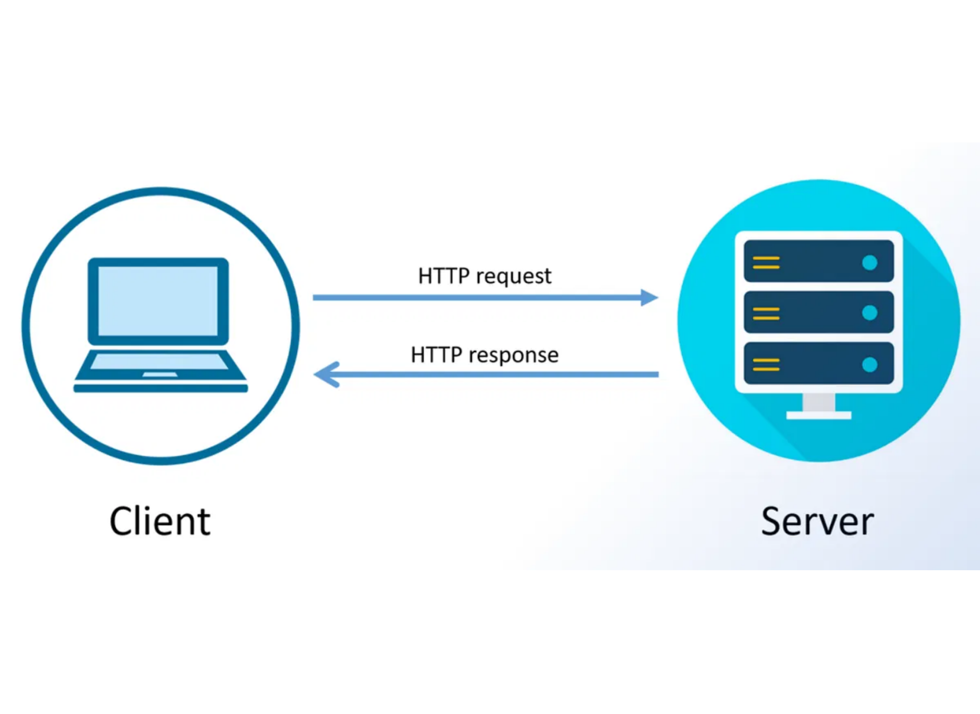
Basic Data Collection
Most regular websites (blogs, news, e-commerce) collect:
IP Address
• Automatically available to any web server
• Reveals approximate location (city level)
• Shows Internet Service Provider
Basic Browser Information
• Browser type and version
• Operating system
• Language preferences
Screen Resolution
// Requires JavaScript to collect const width = screen.width;
const height = screen.height;
HTTP Request-Response Model
Basic Analytics
• Page views and time spent
• Referrer (where you came from)
• Navigation patterns

Slide 4

Advanced Data Collection
High-security websites and ad networks collect significantly more data than regular sites:
Comprehensive Fingerprinting:
• Canvas & WebGL fingerprinting
• Font detection and enumeration
• Hardware characteristics identification
• Audio system fingerprinting
Behavioral Tracking:
• Mouse movement patterns
• Scroll behavior and click timing
• Typing rhythm and cadence
• Session interaction patterns
Cross-Site Profiling:
Why collect this data?
• Tracking across multiple domains
• Financial sites: Fraud prevention, regulatory compliance, security
• Purchase history correlation
• Interest and behavior categorization
• Ad networks: Targeted advertising, user profiling, revenue optimization

Slide 5

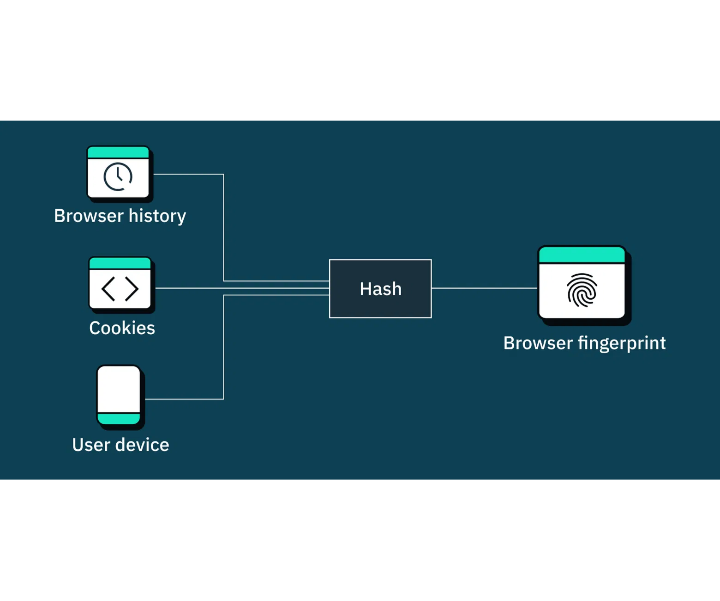
What is Browser Fingerprinting?
Browser fingerprinting
is like taking a "digital fingerprint"
of your browser and device. Just like human fingerprints, the
combination of many small characteristics creates a pattern
that's statistically unique to you.
Think of it like this: If I asked 1000 people their height, many would have the same answer. But if I asked for height + weight + eye color + shoe size + favorite food + birthdate, the combination becomes unique.
What makes fingerprinting powerful:
Works without cookies or storage
Difficult to detect by users
Persists across browsing sessions
Can track across different websites
Hard to change or spoof effectively
Used primarily for
security verification
(banks, financial
sites),
fraud prevention
(e-commerce), and
user tracking
(advertising).

Slide 6

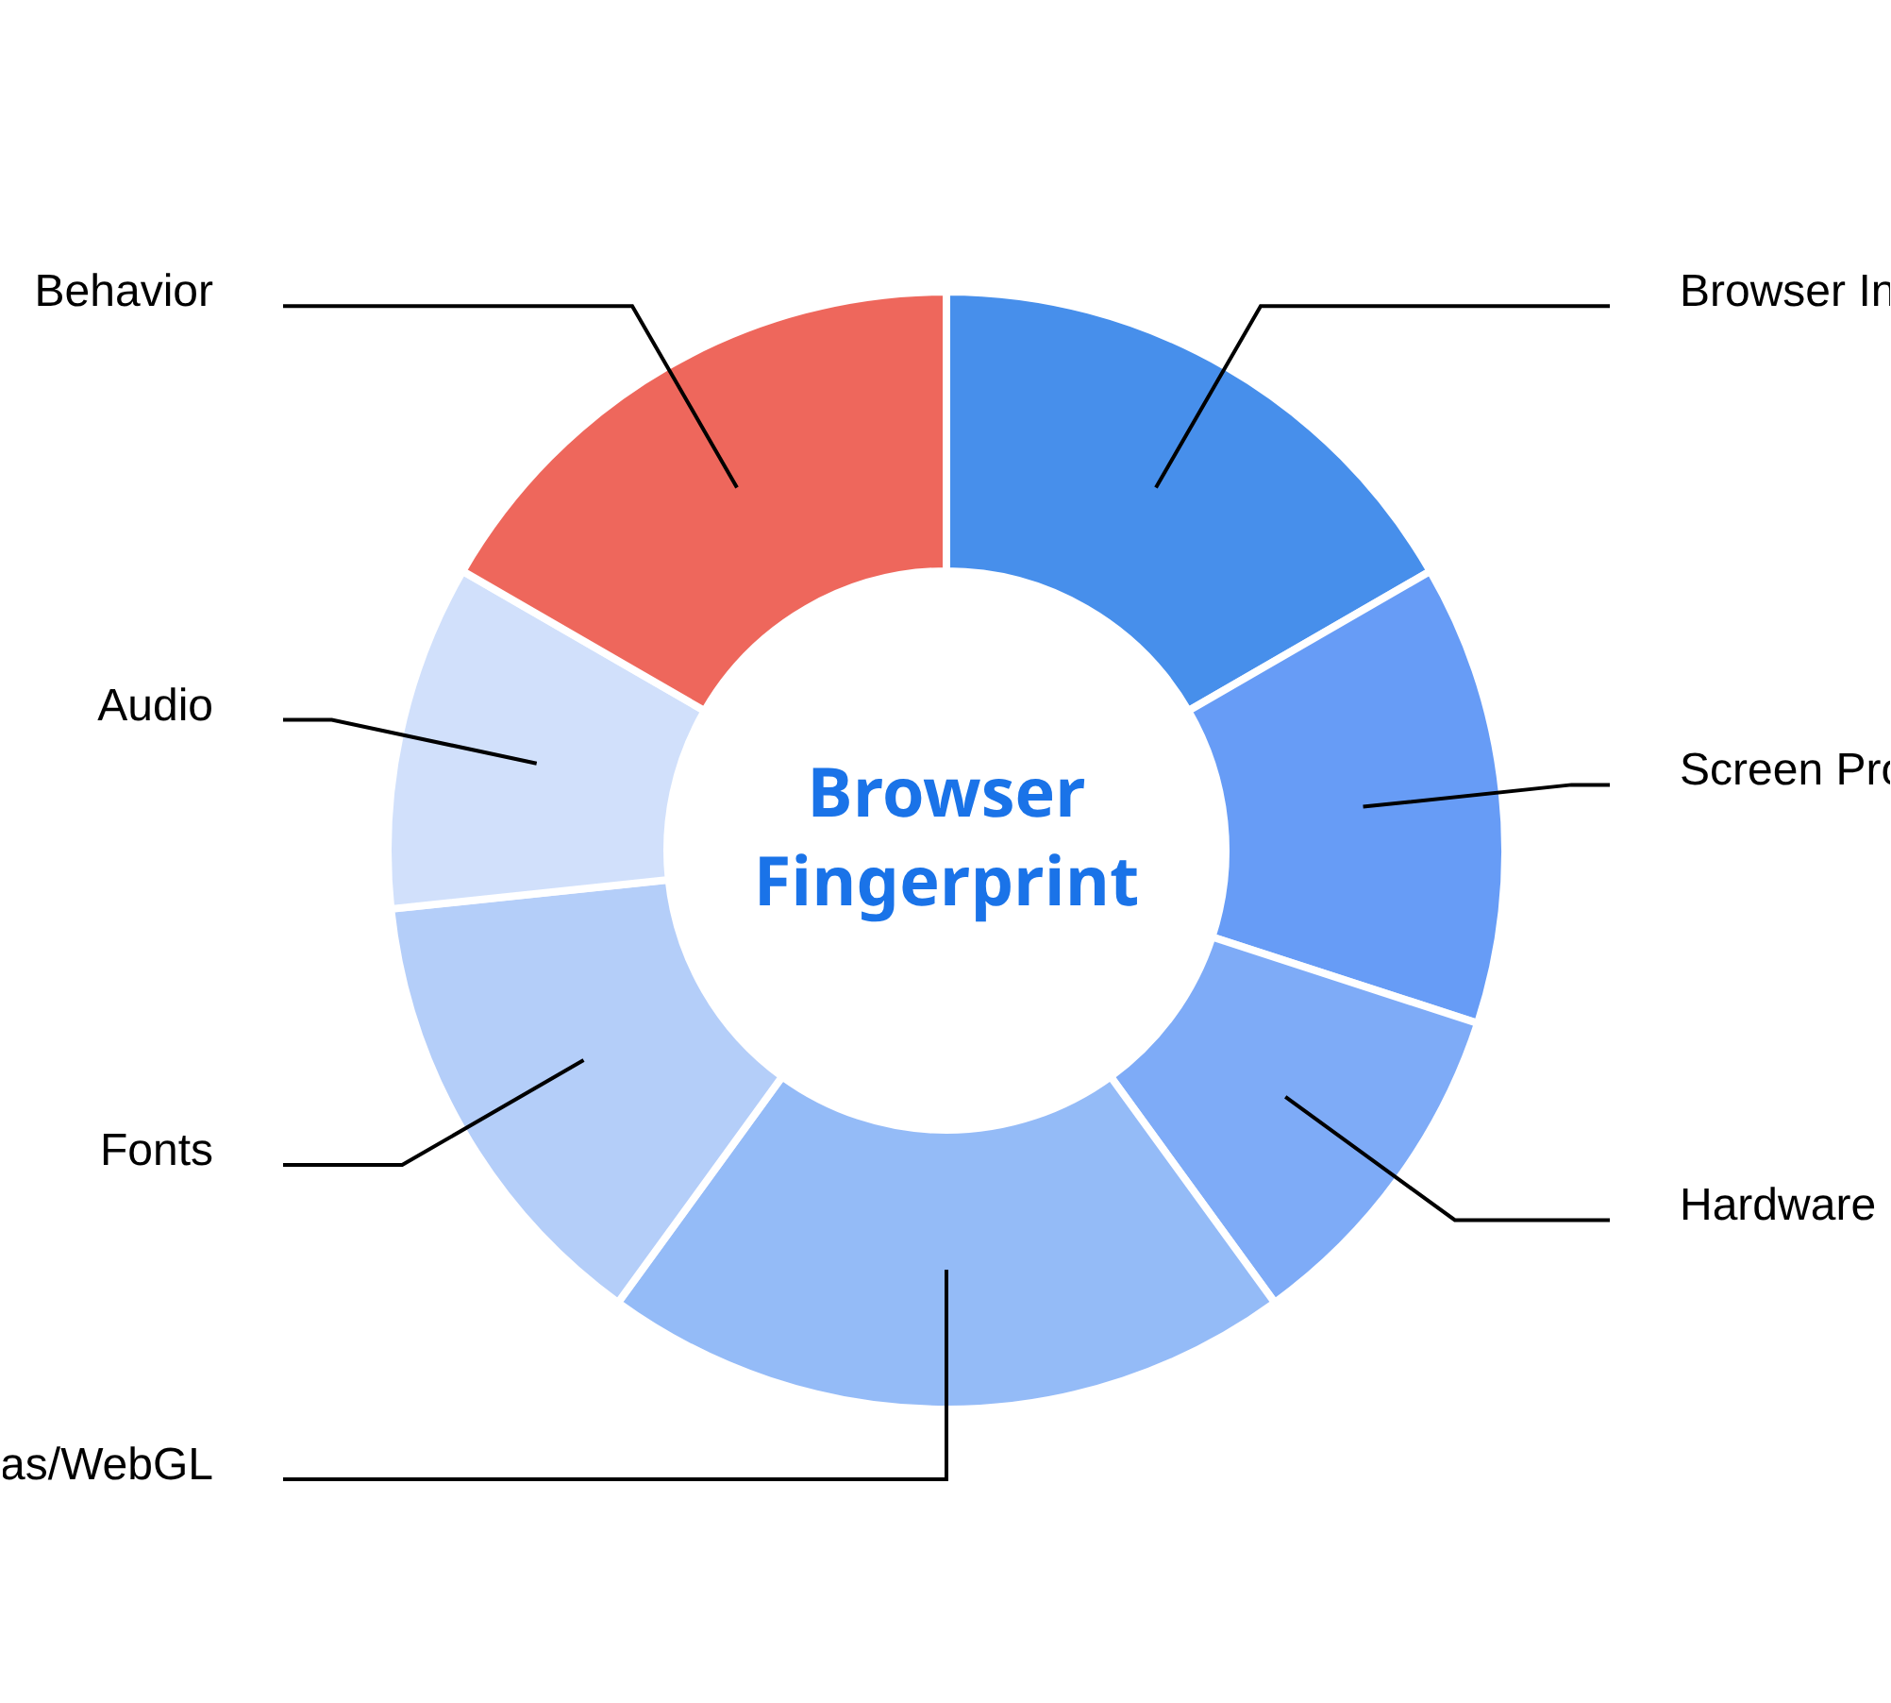
Categories of Fingerprinting Data
Browser fingerprinting collects data across these key categories:
Browser Information
Browser type/version, OS, language, plugins
Screen & Display Properties
Resolution, color depth, pixel density ratio
Hardware Characteristics
CPU cores, graphics card, audio capabilities
Rendering Techniques
Canvas & WebGL fingerprinting, font rendering
Behavioral Patterns
Mouse movements, typing rhythm, interaction patterns
Combined uniqueness:
While individual data points are
common, the combination creates a statistically unique
identifier.

Slide 7

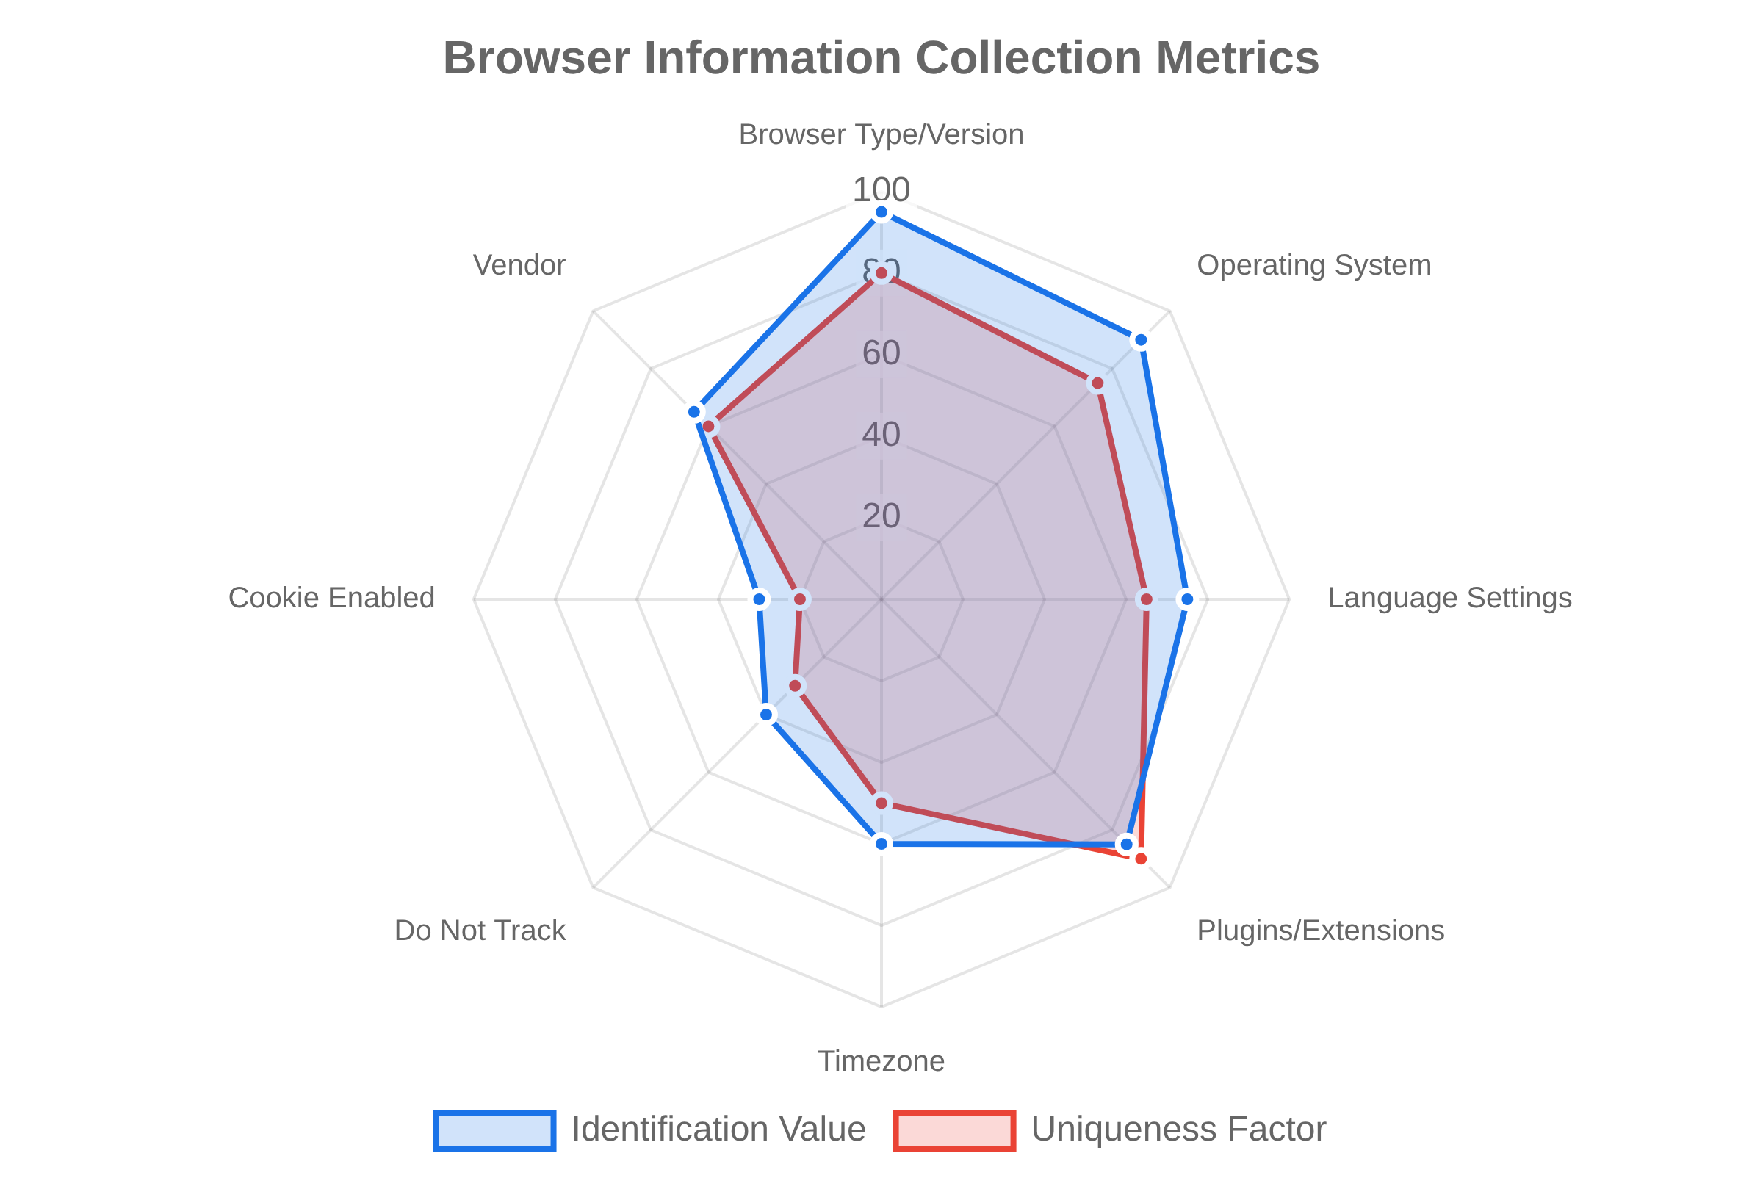
Basic Browser Information
Browser information forms the foundation of fingerprinting, providing key details about the user's software environment:
Browser Type & Version
Identifies Chrome, Firefox, Safari, Edge, etc. and exact version number
navigator.userAgent
Operating System
Detects Windows, macOS, Linux, Android, iOS and version details
Language & Plugins
User's language preferences and installed browser plugins
Why it matters:
Different browsers have different
"signatures" and bot tools often have unusual browser
configurations that can be detected.

Slide 8

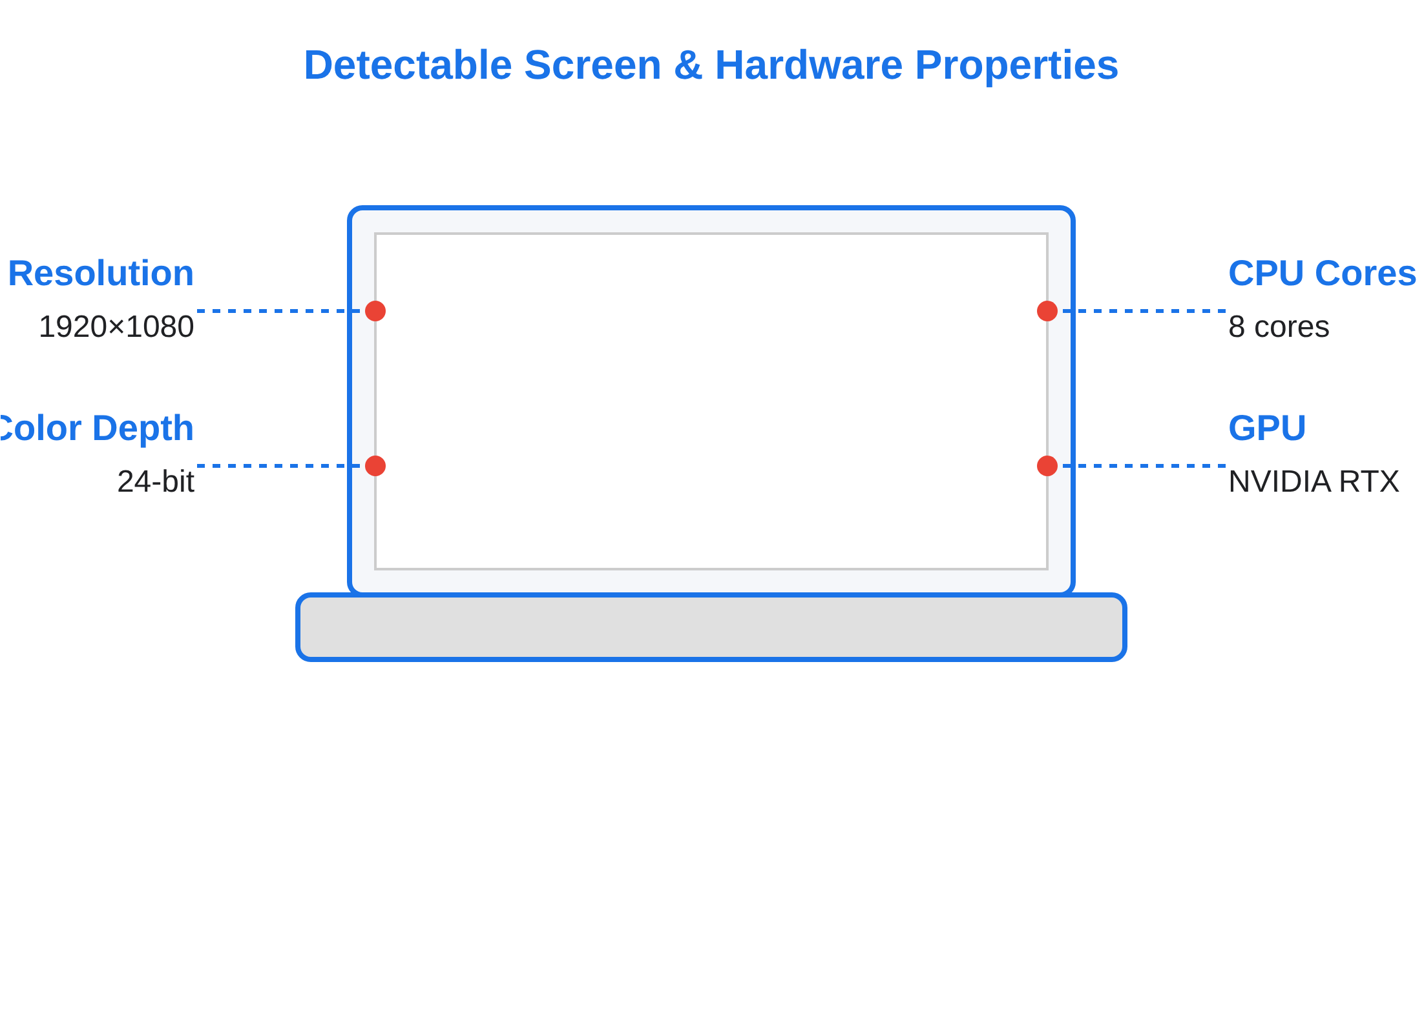
Screen & Hardware Properties
Screen Properties:
Resolution (e.g., 1920×1080)
Color depth & pixel density ratio
Available screen space & multi-monitor setup
const width = screen.width; // 1920
const height = screen.height; // 1080
const pixelRatio = window.devicePixelRatio; // 1.5
Hardware Characteristics:
CPU cores via
navigator.hardwareConcurrency
Graphics card info via WebGL rendering
Battery status & device sensors
const cpuCores = navigator.hardwareConcurrency; // 8
const gpu = getWebGLRenderer(); // "NVIDIA GeForce RTX 3080"
Why it matters:
Hardware configurations create thousands
of possible combinations, making them excellent for
fingerprinting. Bots often run on server hardware with
different signatures.

Slide 9
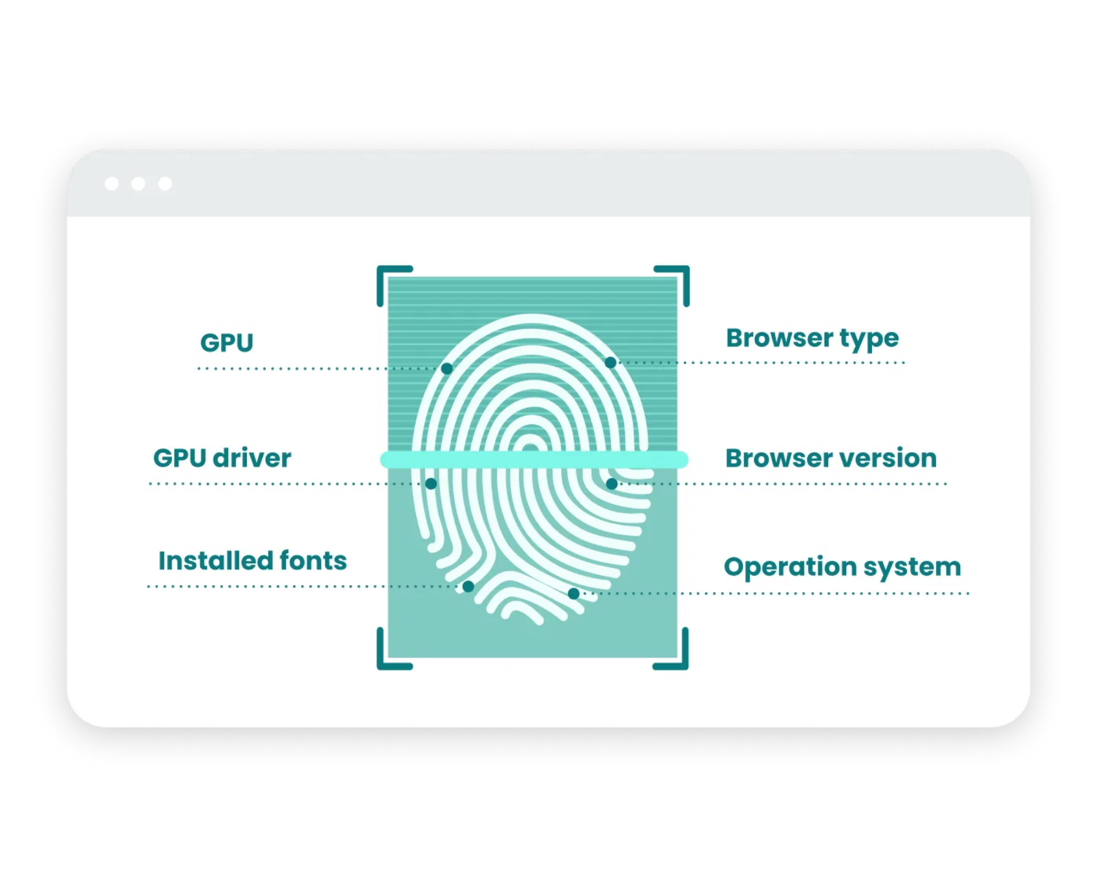
Canvas Fingerprinting
Canvas fingerprinting
captures unique rendering patterns
based on how your browser and hardware render graphics.
// Basic canvas fingerprinting technique const canvas =
document.createElement('canvas');
const ctx = canvas.getContext('2d');
ctx.fillStyle = "#f60";
ctx.fillRect(125, 1, 62, 20);
ctx.fillStyle = "#069";
ctx.font = "11pt Arial";
ctx.fillText("Fingerprint", 2, 15);
const dataURL = canvas.toDataURL();
Why it's effective:
Primary uses:
Graphics cards render differently
Bot detection
Fraud prevention
OS font rendering varies
Cross-session tracking
Nearly impossible to fake
Canvas fingerprinting captures unique rendering characteristics

Slide 10

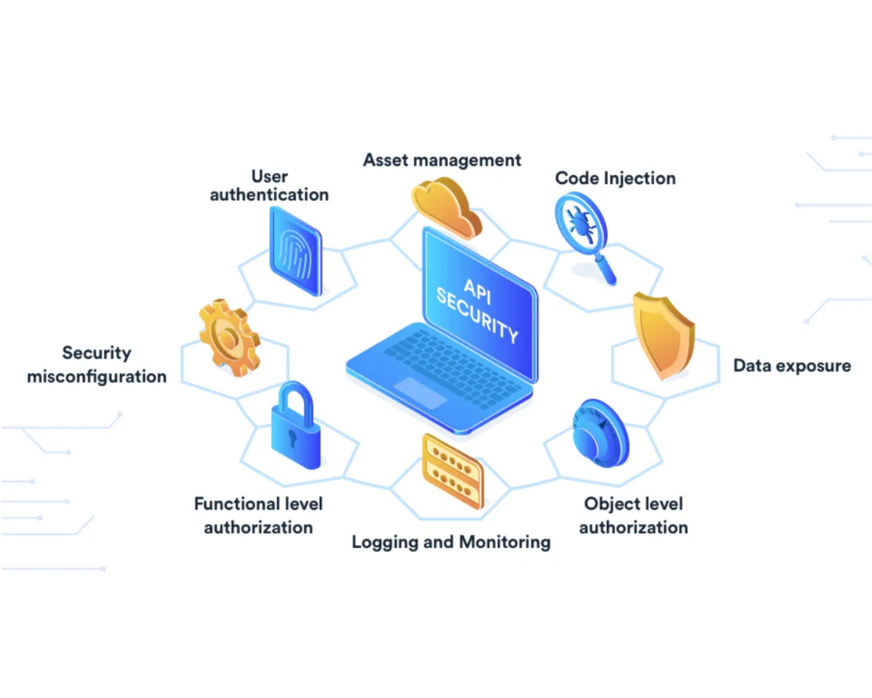
WebGL & Audio Fingerprinting
WebGL Fingerprinting
Captures unique characteristics of graphics hardware:
Graphics card manufacturer and model
Driver version and rendering capabilities
Hardware-specific rendering quirks
Why effective:
Creates consistent rendering signatures.
Audio Fingerprinting
Analyzes how your device processes audio signals:
Audio processing characteristics
Digital signal processing variations
Hardware-specific audio signatures
Why it works:
Each audio system has measurable
differences.
What makes these techniques powerful:
Hardware-based (difficult to fake)
Examples of canvas fingerprinting variations across devices
Consistent across browsing sessions
Invisible to users (no permission required)

Slide 11

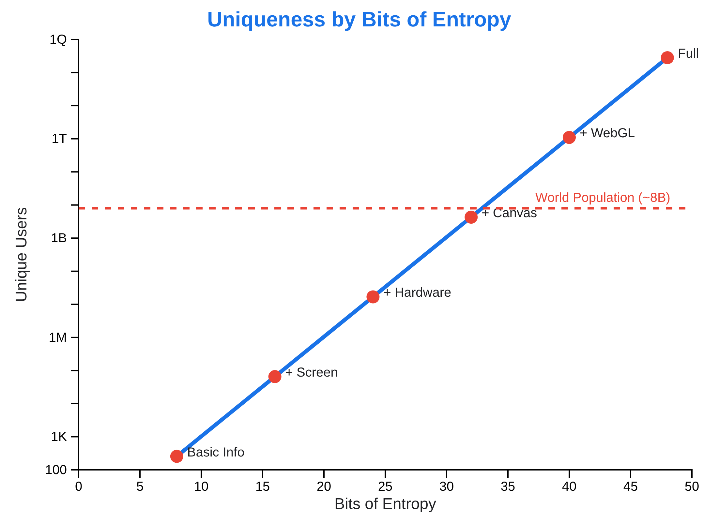
The Mathematics of Uniqueness
Individual browser characteristics are common, but their
combination
creates statistical uniqueness:
Chrome browser:
~65%
Windows 11:
~25%
1920×1080 screen:
~20%
All combined:
3.25%
Entropy Calculation
Each characteristic adds "bits of entropy" to the fingerprint:
Screen resolution:
~6 bits
Font list:
~10 bits
Canvas fingerprint:
~15 bits
WebGL signature:
~12 bits
Total entropy:
~50+ bits
With 50 bits of entropy, the chance of duplicate fingerprints:
P(duplicate) = 1 / 2
50
≈ 1 in 1 quadrillion

Slide 12

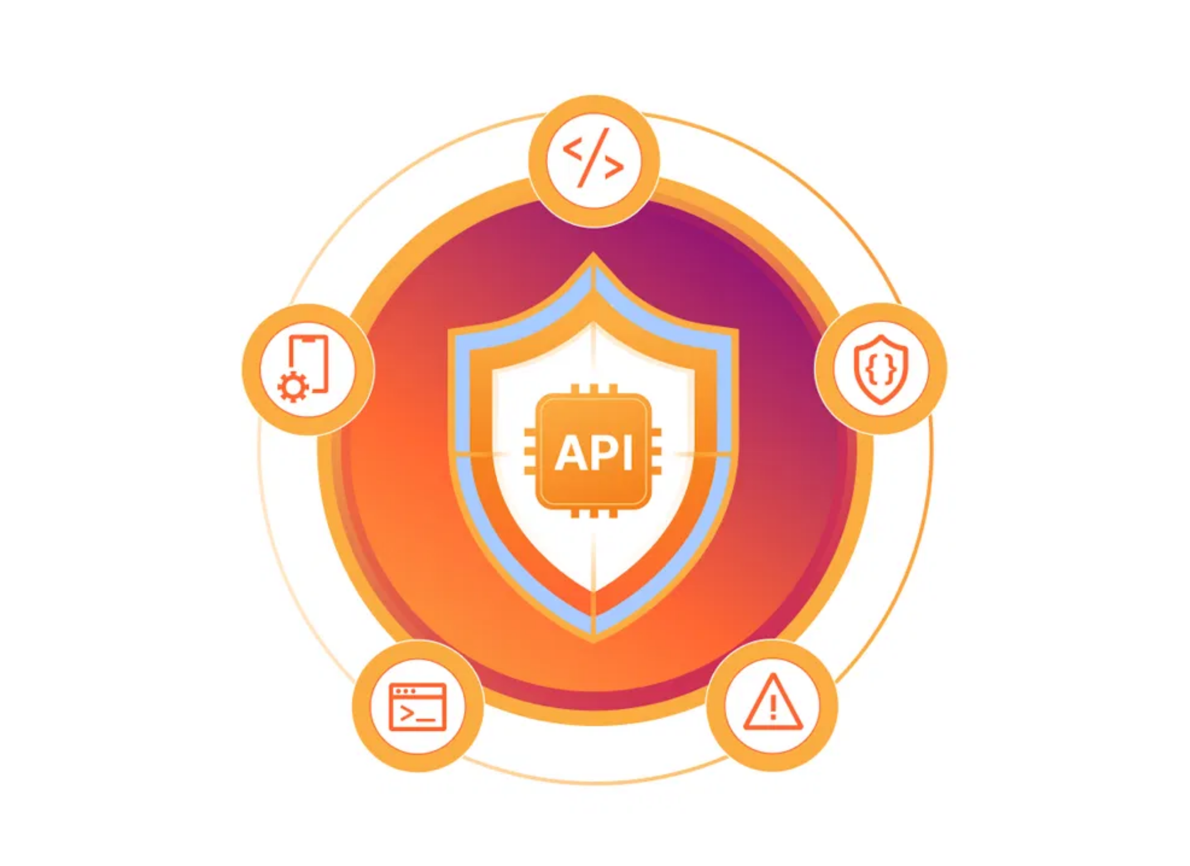
HTTP Fundamentals & The Problem
HTTP is Stateless
Each HTTP request is independent
No inherent memory between requests
Server doesn't automatically know if two requests come from the same user
Creating Artificial "State"
Cookies store identifiers on client side
Sessions maintain user context on server side
Authentication tokens validate identity
The Challenge:
How to distinguish between:
Legitimate browser users
Automated bots/scrapers
Malicious attackers
This is where fingerprinting and advanced session validation become critical for API protection.
HTTP Request-Response Model

Slide 13






What Are Web Cookies?
Cookies are
small text files
with data that websites store on your
device.
Created by web servers when you visit websites
Contain unique identifiers and user data
Exchanged between browser and server
Stored locally in your web browser
Help websites recognize and remember you
Think of cookies as
digital tickets
that identify you when you return to a
website.
1

Slide 14
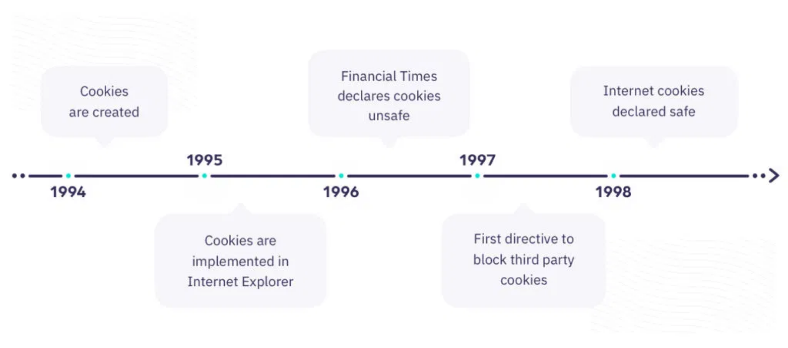
History and Evolution of Cookies
Cookies were invented in
1994
by Lou Montulli, a programmer at
Netscape.
1994
Lou Montulli creates cookies for Netscape Navigator
1995
Internet Explorer adds cookie support
1997
First attempts to regulate cookies (RFC 2109)
2000
RFC 2965 standardizes HTTP State Management
2009
EU introduces cookie consent requirements
2018
GDPR strengthens cookie privacy regulations
2023
Major browsers begin phasing out third-party cookies
2

Slide 15
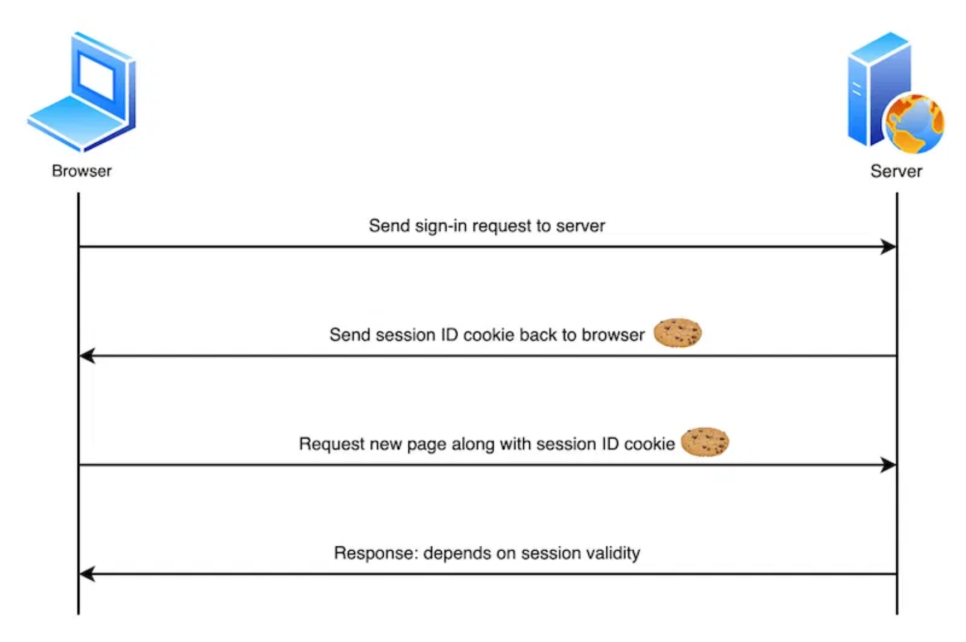
How Cookies Work
Cookies function like a
coat check system
between your browser and
websites.
1
First Visit:
When you visit a website, the server generates a cookie with
a unique ID and sends it to your browser.
2
Storage:
Your browser stores this cookie locally on your device.
3
Return Visit:
When you revisit the site, your browser sends the cookie
back to the server.
4
Recognition:
The server reads the cookie's unique ID and retrieves your
information.
This process enables websites to
remember your preferences
, keep you
logged in, and provide personalized experiences.
3

Slide 16
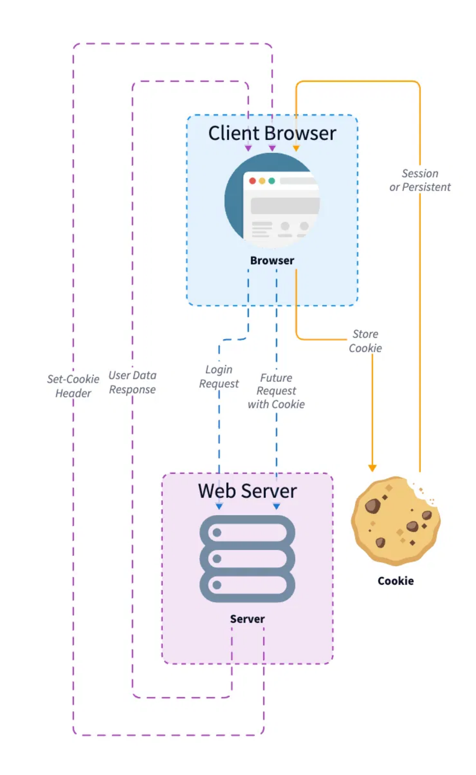




Types of Cookies
Cookies come in several
different types
, each serving specific
purposes.
Session vs. Persistent
Session cookies
expire when you close your browser, while
persistent cookies
remain for a set period of time.
First-Party vs. Third-Party
First-party cookies
are set by the website you're visiting, while
third-party cookies
are set by other domains (often for tracking).
Secure & HttpOnly
Secure cookies
are only sent over HTTPS connections.
HttpOnly cookies
can't be
accessed by JavaScript, protecting against XSS attacks.
Zombie Cookies
Zombie cookies
recreate themselves after deletion by storing backups outside the
browser's standard cookie storage location.
4

Slide 17
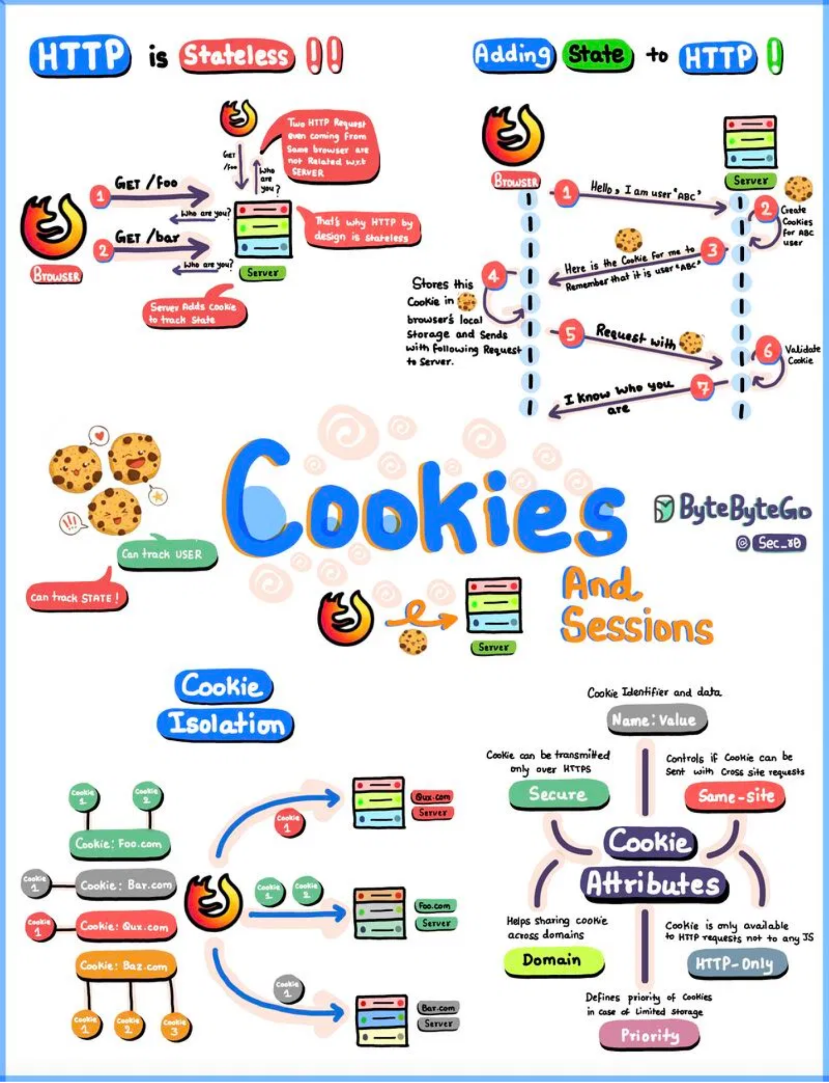





How Websites Use Cookies
Websites implement cookies for
various essential functions
that
enhance user experience.
Authentication
Remembering login status and user credentials across sessions
Shopping Carts
Storing items in your cart while you continue browsing
Preferences
Saving language settings, themes, and display options
Analytics
Tracking user behavior to improve site functionality
Targeted Advertising
Delivering personalized ads based on browsing history
5

Slide 18






Benefits of Cookies
Cookies provide
significant advantages
for both websites and users.
Personalized Experience:
Cookies remember your preferences,
language settings, and customizations.
Convenient Authentication:
Stay logged in across sessions without re-
entering credentials.
Shopping Cart Retention:
Items remain in your cart even if you close
the browser.
Improved Performance:
Websites load faster by storing data locally
instead of requesting it repeatedly.
Analytics and Optimization:
Helps websites understand user behavior
to improve functionality.
6

Slide 19
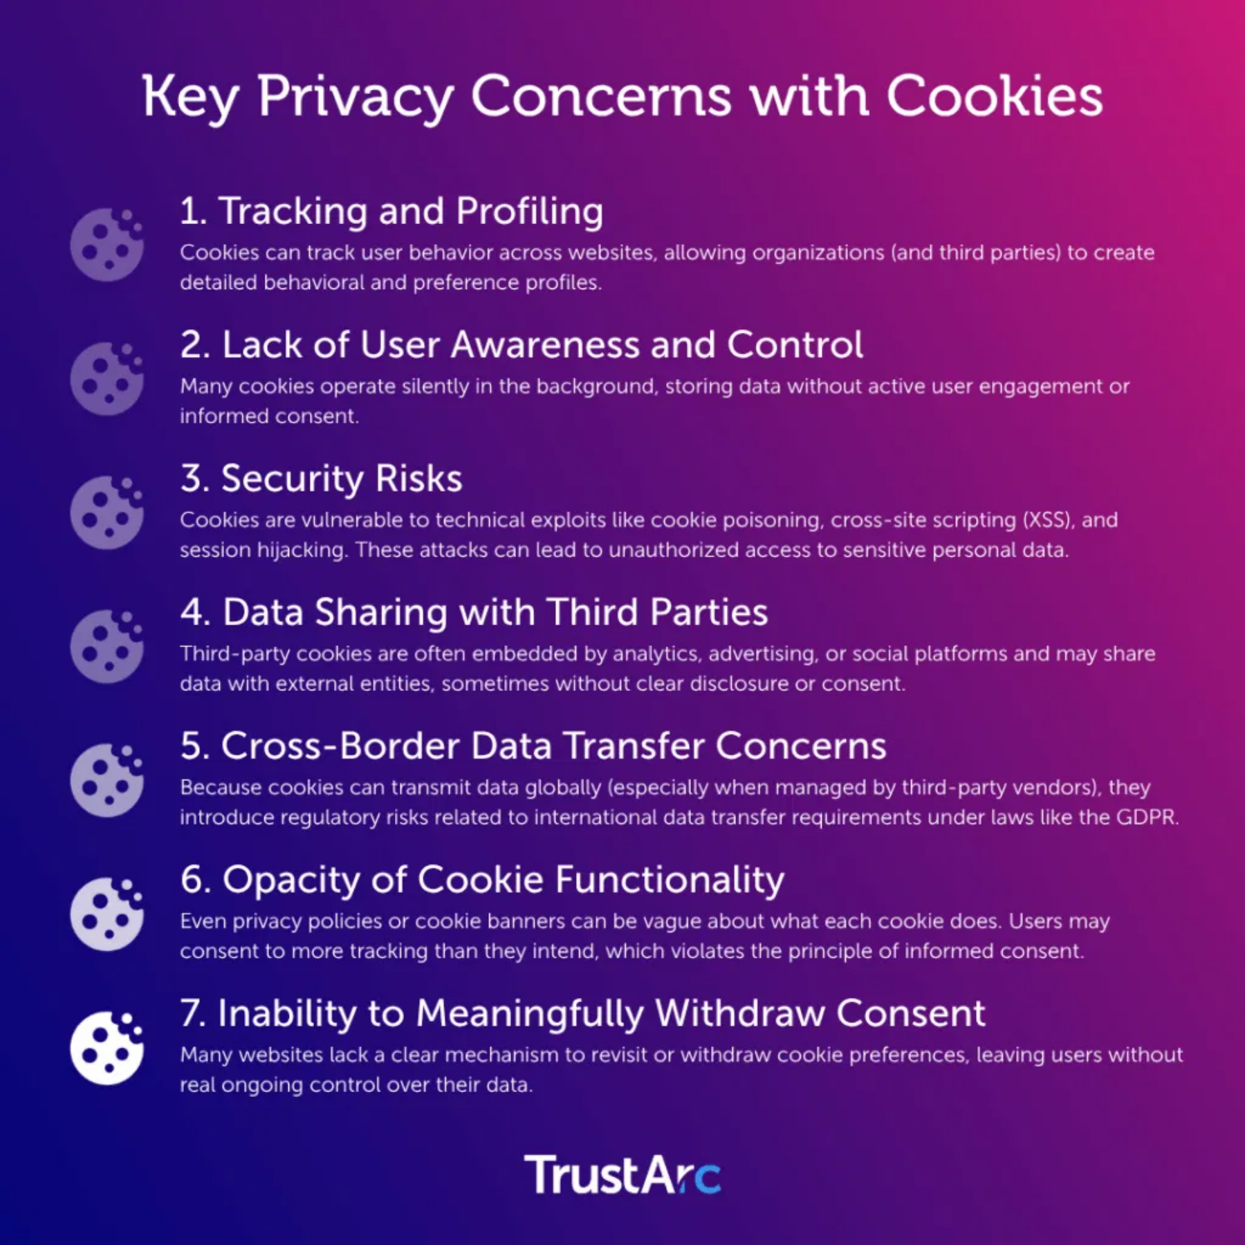




Cookie Security Concerns
Cookies can pose
significant security risks
if not properly managed.
Session Hijacking:
Attackers can steal session cookies to impersonate
users and gain unauthorized access.
Cross-Site Scripting (XSS):
Malicious scripts can steal cookies if they're
not properly protected.
Man-in-the-Middle Attacks:
Unencrypted cookies can be intercepted
during transmission.
Cookie Poisoning:
Modifying cookie contents to manipulate application
behavior.
Implementing
HTTPS, secure flags, and HttpOnly attributes
can help
mitigate these risks.
7

Slide 20
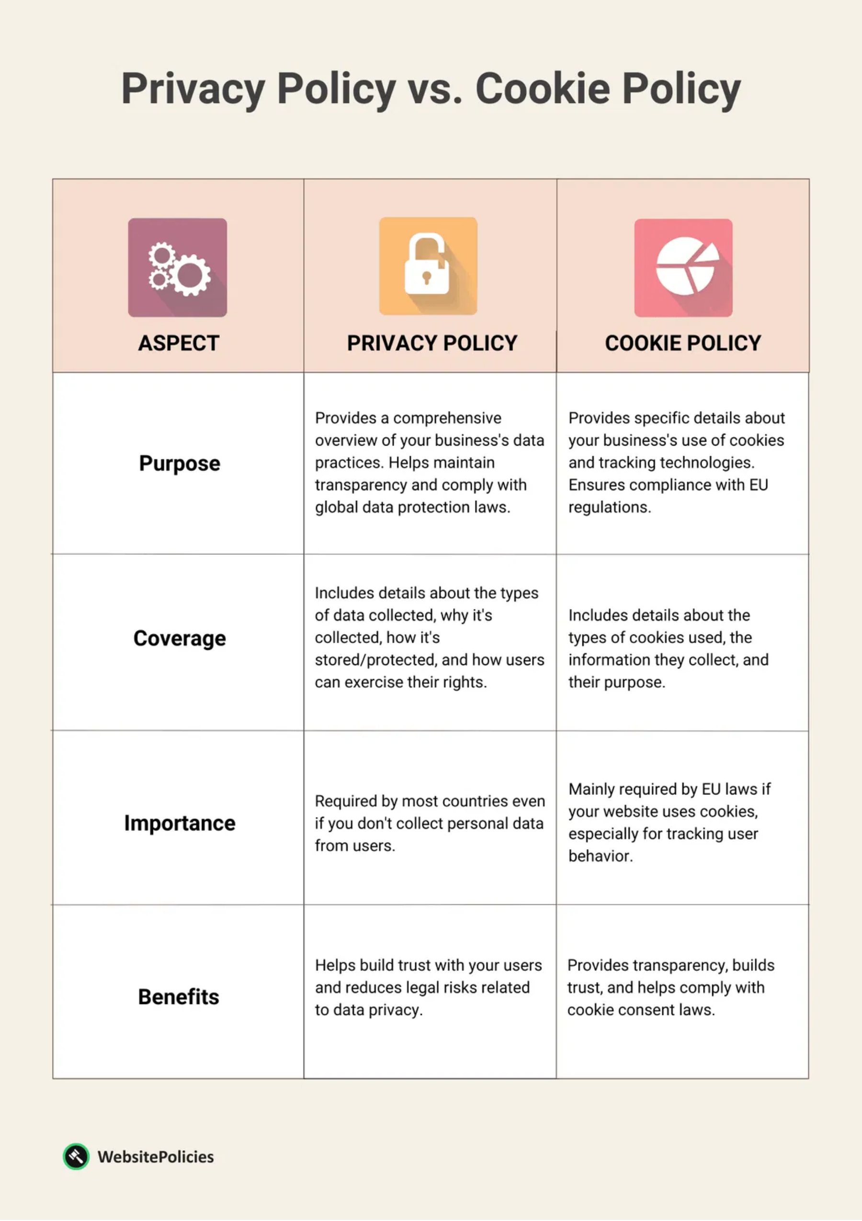




Privacy Implications
Cookies raise significant
privacy concerns
that have led to global
regulations.
User Tracking:
Cookies can track browsing behavior across multiple
websites, creating detailed user profiles without explicit consent.
Regulations:
GDPR in Europe and CCPA in California require websites to
obtain informed consent and disclose cookie usage.
Consent Requirements:
Websites must provide clear options to accept,
reject, or customize cookie settings.
Privacy Policies:
Organizations must maintain separate cookie policies
explaining what data is collected and how it's used.
The balance between personalization and
user privacy
remains an ongoing
challenge.
8

Slide 21
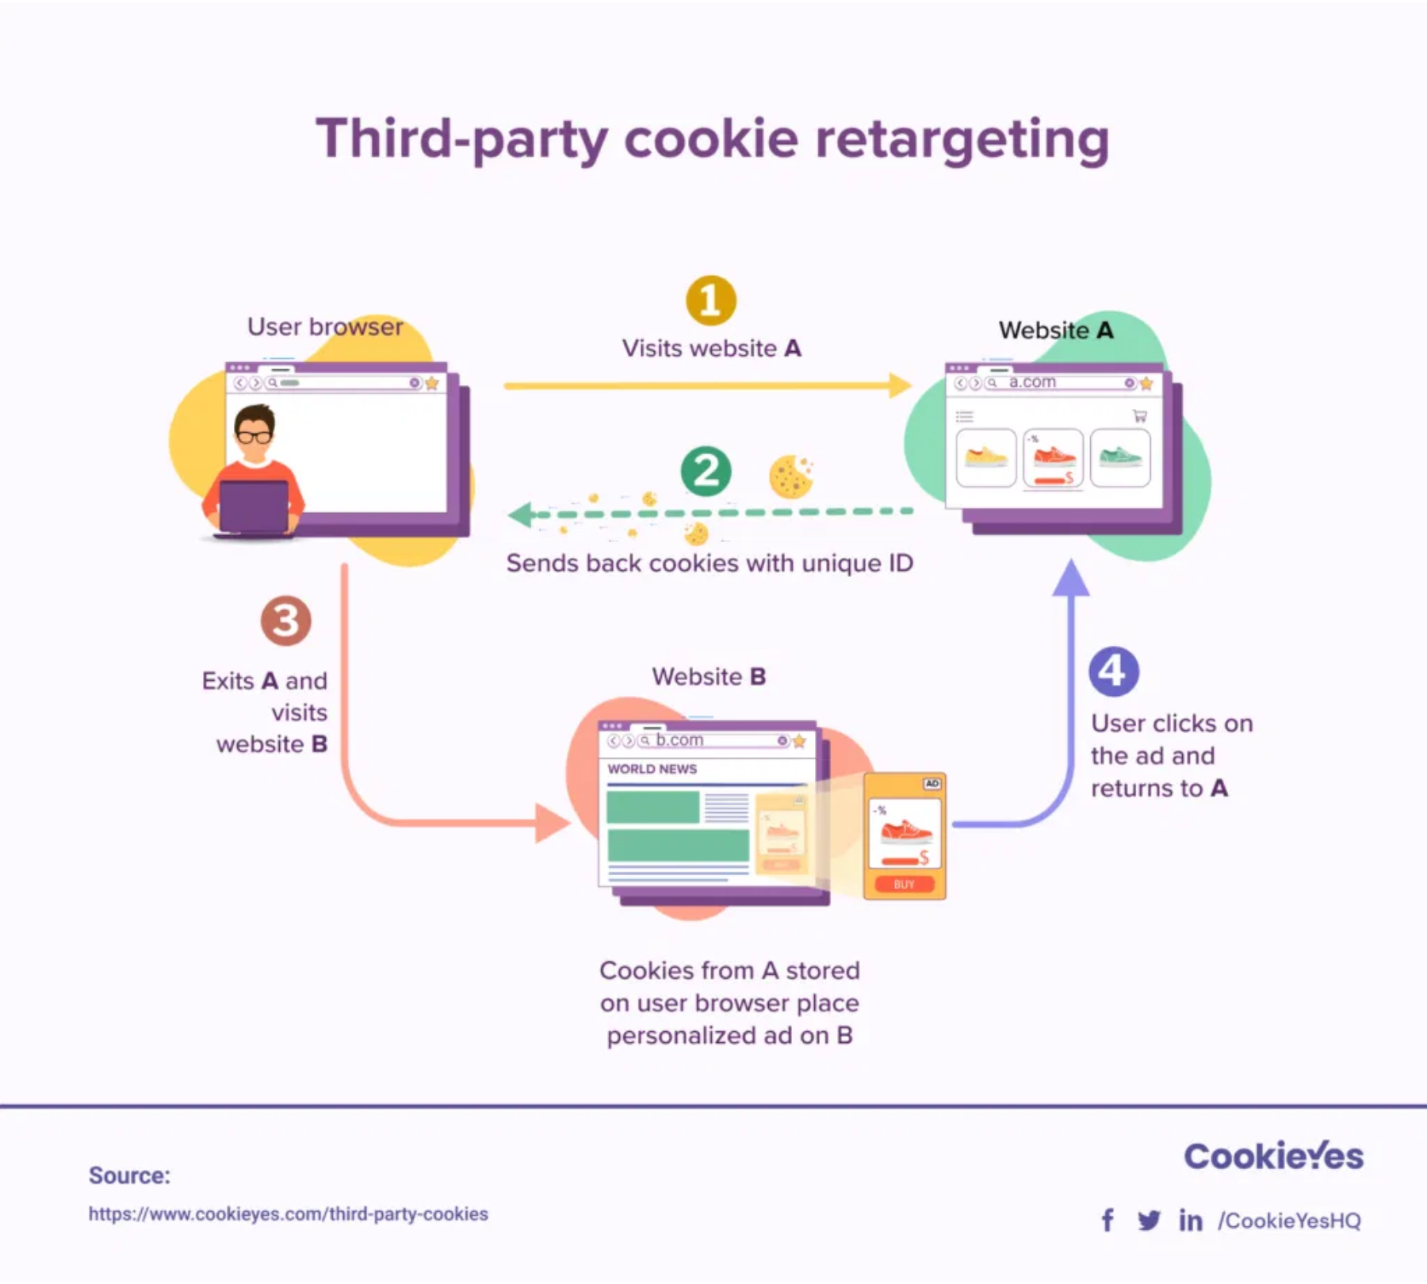
Third-Party Cookies and Tracking
Third-party cookies are set by domains
other than the one you're
visiting
, primarily for cross-site tracking.
1
Initial Visit:
You visit Website A, which includes content from an ad
network that places its cookie in your browser.
2
Cookie Storage:
The third-party cookie contains a unique identifier
linked to your browsing activity.
3
Cross-Site Tracking:
When you visit Website B that uses the same ad
network, your browser sends the cookie back to the ad network.
4
Profile Building:
The ad network builds a profile of your browsing habits
across multiple websites.
Major browsers are now
phasing out third-party cookies
due to privacy
concerns.
9

Slide 22

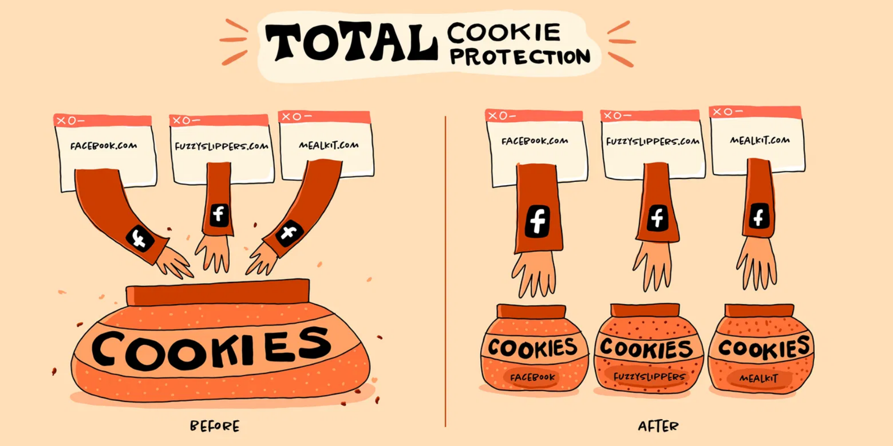



Future of Cookies and Alternatives
The cookie landscape is
rapidly evolving
with privacy-focused
alternatives emerging.
Privacy Sandbox:
Google's initiative to replace third-party cookies with
privacy-preserving APIs for targeted advertising.
Fingerprinting:
Identifying users based on device characteristics without
cookies, though raising its own privacy concerns.
First-Party Data:
Websites collecting data directly from users with
explicit consent rather than through third parties.
Total Cookie Protection:
Browser features that isolate cookies to the
websites that created them, preventing cross-site tracking.
The future web will likely balance
personalization with enhanced privacy
controls
for users.
10

Slide 23

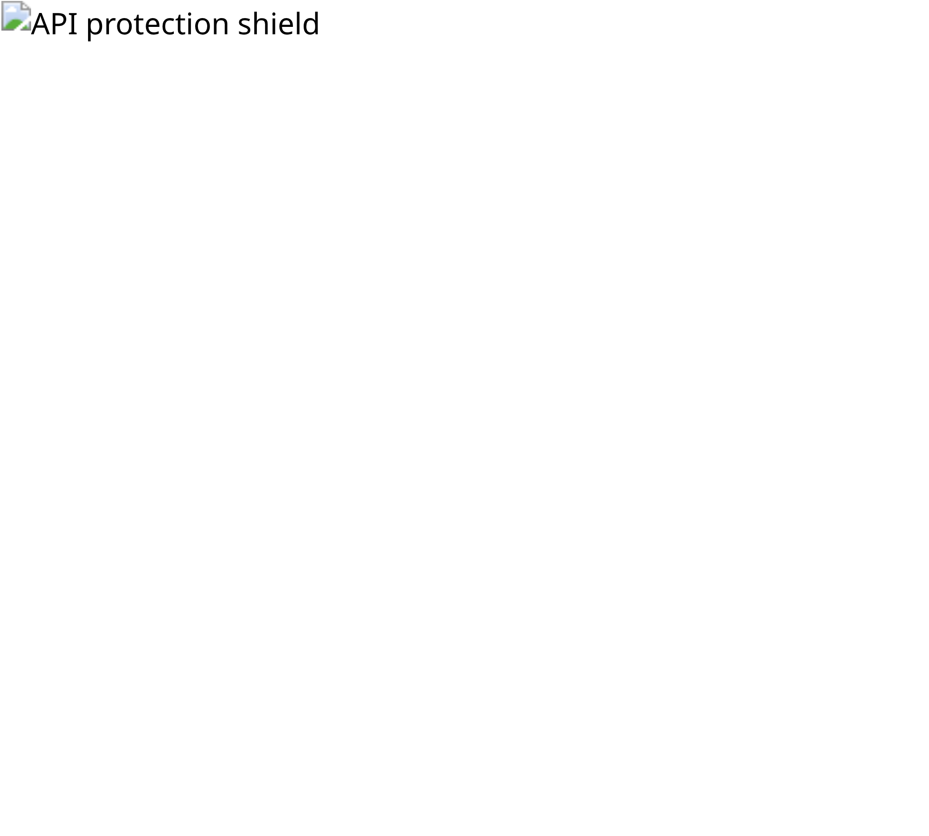
NSE API Protection: The Challenge
The National Stock Exchange (NSE) implements sophisticated API protection mechanisms to prevent unauthorized data scraping and ensure fair market access.
The Challenge:
How to distinguish between legitimate
browser users and automated bots/scrapers?
Scenario 1: Direct Python Request
import requests
response = requests.get("https://www.nseindia.com/api/historical/...")
# Result: 404 Resource Not Found
Missing: session cookies, browser fingerprint, legitimate headers
Scenario 2: Browser Direct URL
User types API URL directly in browser address bar
Still fails with 404 error - no prior interaction with nseindia.com
Scenario 3: Browser After Site Visit
Visit nseindia.com → JavaScript execution → Session established → API call succeeds

Slide 24

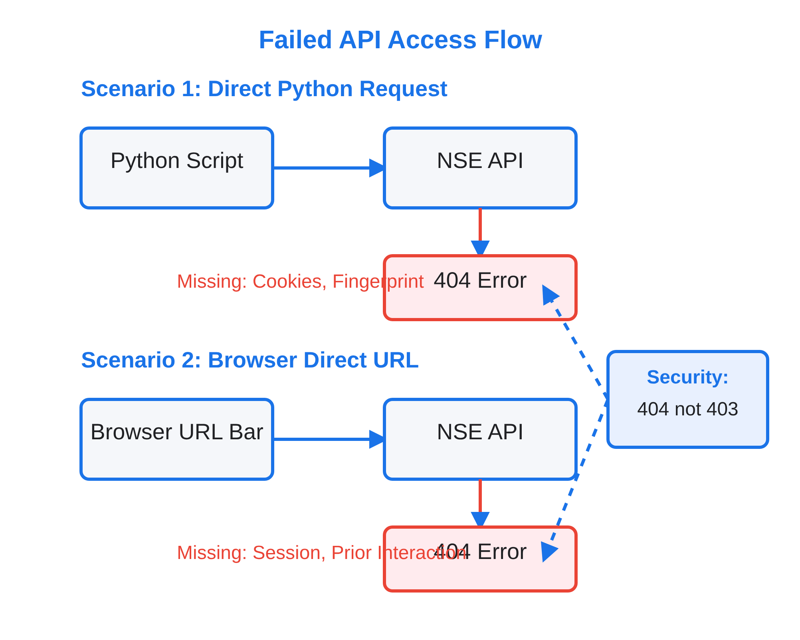
Scenarios 1 & 2: Failed API Access
Scenario 1: Direct Python Request
import requests
response = requests.get("https://www.nseindia.com/api/historical/...")
# Result: 404 Resource Not Found
Why it fails:
No session cookies established
No browser fingerprint validation
Missing browser-specific headers
Scenario 2: Browser Direct URL
https://www.nseindia.com/api/historical/...
# Result: Still 404 Error
Why it fails:
Fresh browser session = no NSE cookies
No prior interaction with nseindia.com
Server treats it same as bot request
Security measure:
Returns
404 error
(not found) rather than 403 (forbidden)
to obscure the API's existence.

Slide 25

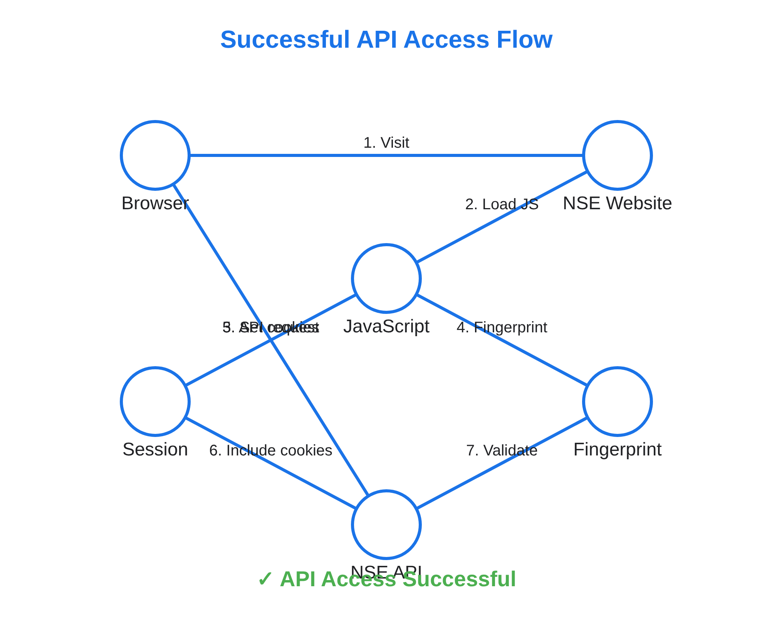
Scenario 3: Successful API Access
When accessing the NSE API
after visiting the website first
,
the request succeeds because proper session establishment
and fingerprinting occur:
Step 1: Visit nseindia.com
Browser loads the main site, establishing initial session cookies:
Set-Cookie: nsit=xyz123; AKA_A2=abc456; bm_sz=def789
Step 2: JavaScript Execution
Collect screen resolution, timezone
Perform canvas & WebGL fingerprinting
Mark session as "legitimate" in backend
Step 3: API Call Success
Valid session cookies from Step 1
Proper Referer header (nseindia.com)
Browser fingerprint validation
Key insight:
The API requires proof of legitimate browser
interaction with the main site before allowing data access.

Slide 26

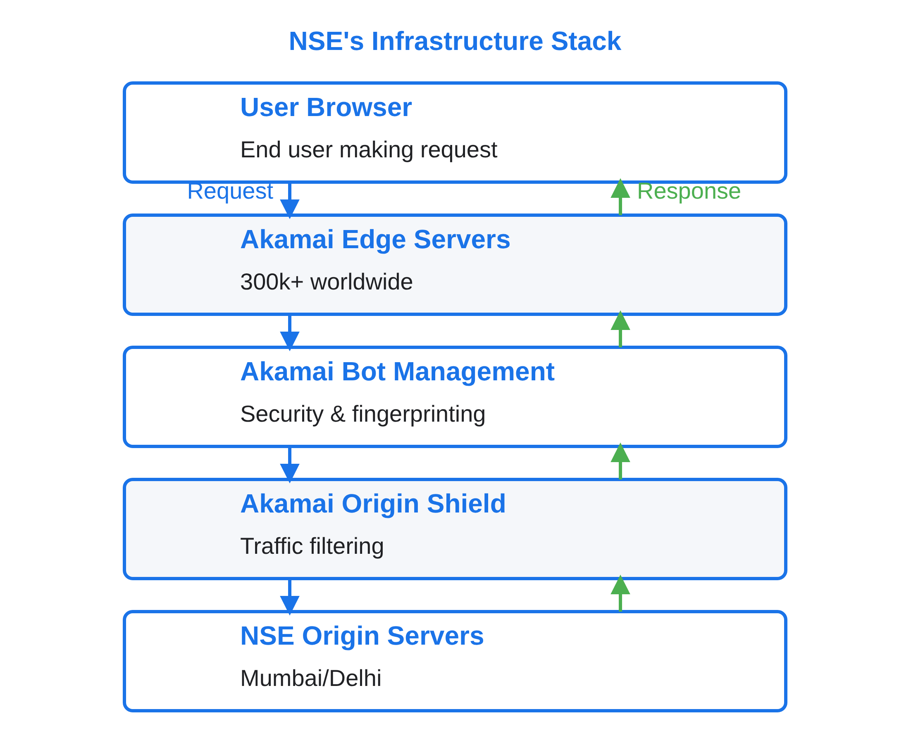
Akamai CDN Layer
What is Akamai-GRN?
akamai-grn
= "Akamai Ghost Request Number"
Unique identifier for each request
Tracks request journey through Akamai network
Used for debugging, monitoring, and security
Example: 0.4f123abc-1692456789.123-456789
0.4f123abc: Edge server ID
1692456789: Unix timestamp
123-456789: Request sequence & tracking IDs
Additional Akamai Headers
akamai-cache-status: Hit/Miss/RefreshHit
akamai-request-bc: IN (country code)
akamai-server-ip: 23.200.241.64
akamai-transformed: 9 0 (optimization flags)
NSE leverages Akamai's global network of
300,000+ edge
servers
to provide security, performance, and bot
management capabilities before requests reach their origin
servers.

Slide 27

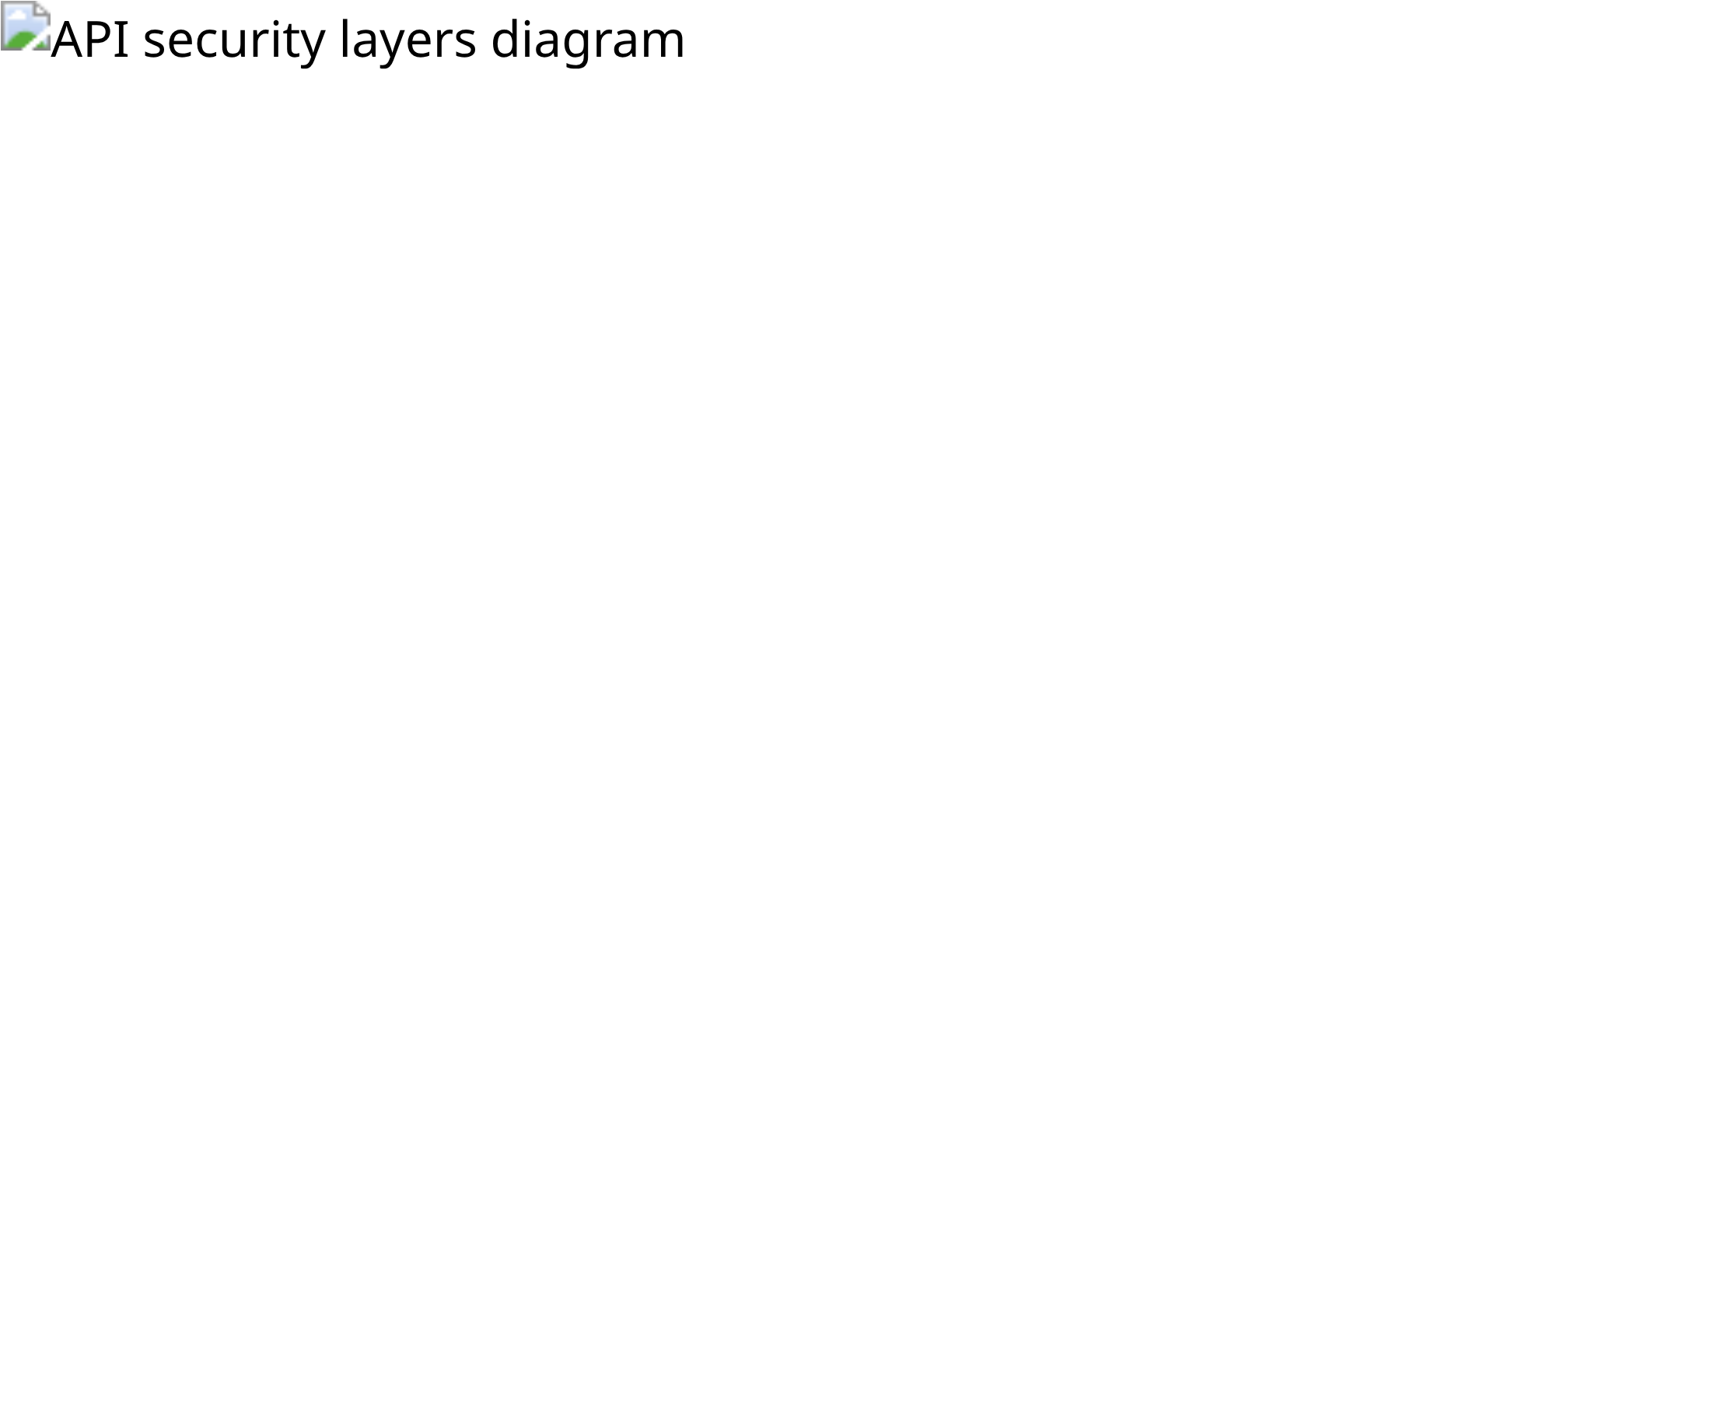
Multi-Layer Protection Mechanisms
NSE and other financial platforms implement multiple layers of protection to distinguish legitimate users from bots:
Layer 1: Akamai Edge Protection
TLS and HTTP/2 fingerprinting
Behavioral detection (mouse movements, scrolling)
Machine learning models trained on human vs. bot patterns
Layer 2: Session-Based Validation
Multiple required cookies (nsit, AKA_A2, bm_sz)
Session lifecycle tracking and validation
Redis-based session storage with expiration
Layer 3: Browser Fingerprinting
Hardware fingerprinting (screen, CPU, GPU)
Canvas and WebGL rendering signatures
Font enumeration and audio processing
Layer 4: Header Validation
Referer validation (must be from NSE domain)
API Security Protection Layers
User-Agent analysis for legitimate browser patterns
Accept headers and header sequence validation

Slide 28

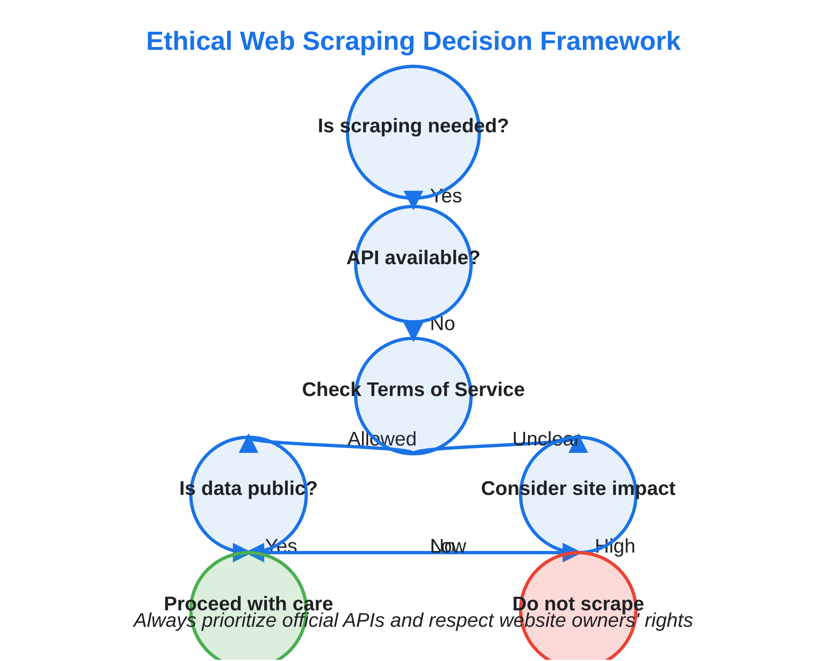
Ethical & Legal Considerations
Terms of Service
Most websites explicitly prohibit automated data collection in their Terms of Service, creating potential legal liability for scrapers.
Server Load & Resource Usage
Aggressive scraping can impact website performance, increasing costs for site owners and degrading experience for legitimate users.
Data Privacy Regulations
Collecting and storing personal data may violate GDPR, CCPA, and other privacy laws, even if the data was publicly accessible.
Intellectual Property Rights
Content may be protected by copyright, database rights, or other IP protections that restrict collection and reuse.
Best Practice:
Always seek API access or explicit permission before scraping commercial websites, especially those with sensitive data or sophisticated protection mechanisms.

Slide 29

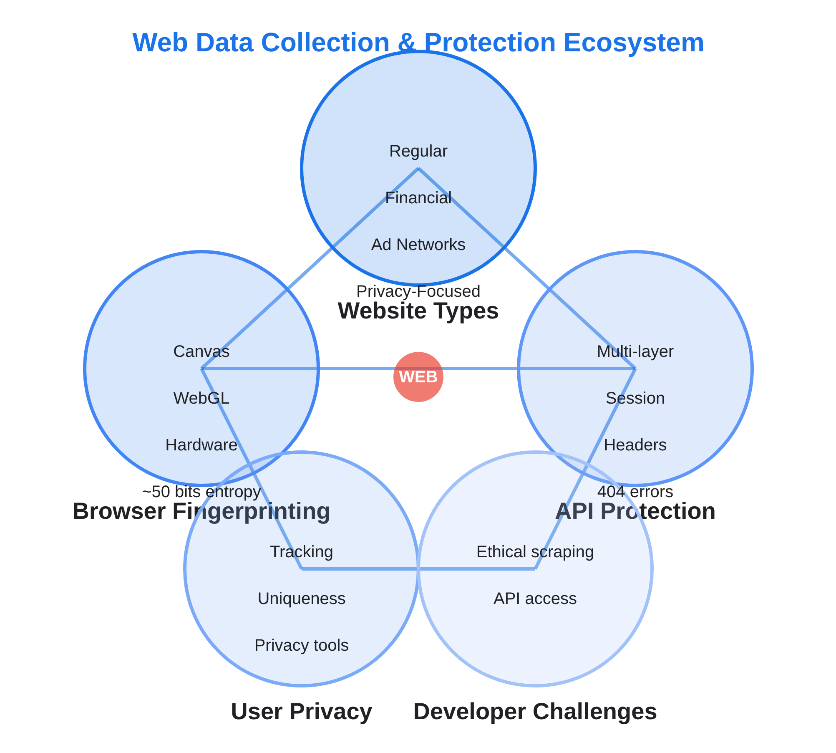
Key Takeaways
Website Data Collection Spectrum
Different websites collect varying levels of data, from basic analytics on regular sites to comprehensive fingerprinting on financial and ad-driven platforms.
Browser Fingerprinting Power
The combination of seemingly innocent data points creates a statistically unique identifier (~50 bits of entropy) that can track users across sessions without cookies.
Multi-Layer API Protection
Modern security systems like NSE's use multiple validation layers: edge protection, session validation, fingerprinting, and header analysis to distinguish humans from bots.
Practical Implications
For users: Privacy tools can help limit tracking but may break functionality on security-focused sites. For developers: Understanding these mechanisms is crucial for ethical web scraping and API integration.

